Slide 1
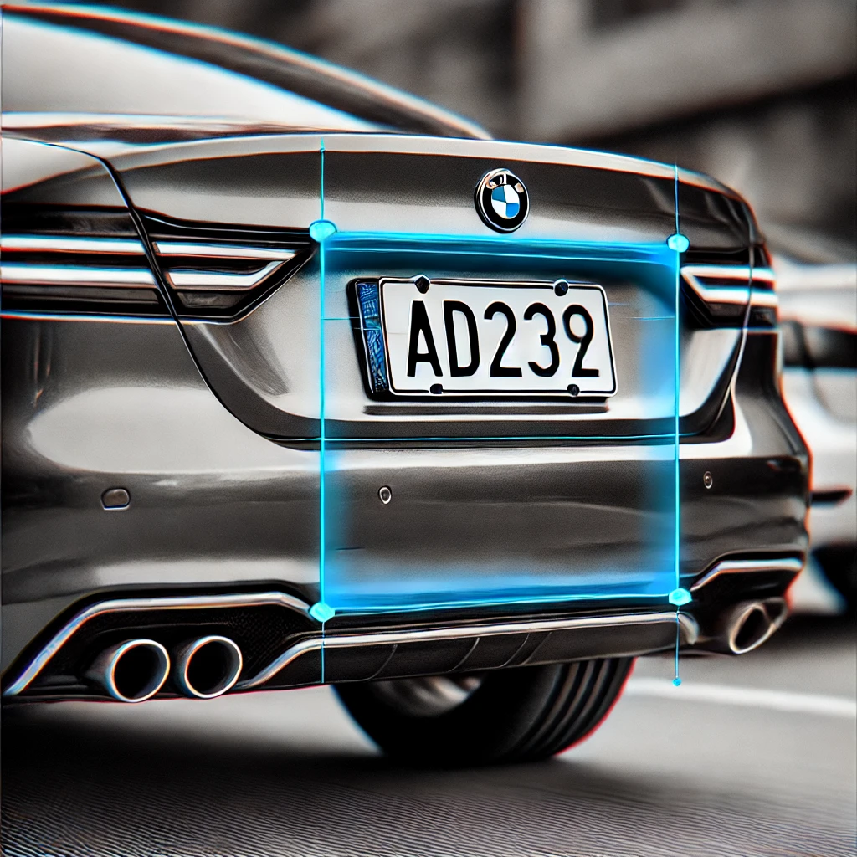

Number Plate Detection
Name : nirmit kotadiya
Branch : cse

Slide 2
INTRODUCTION
Project Overview:
This project focuses on detecting vehicle number plates from images using computer vision techniques.
It involves identifying the number plate region from car images using image processing methods.
Languages and Libraries:
Python, OpenCV, datetime, OS
Real-World Application:
Useful in automated toll systems, parking management, and traffic surveillance for vehicle identification.

Slide 3
PROBLEM STATEMENT
Challenge:
Automating number plate detection to assist with vehicle identification without human intervention.
Solution:
This system detects the location of number plates in car images, making it easier to isolate and analyze vehicle information.

Slide 4
EXTERNAL LIBRARIES USED
OpenCV (cv2):
Used for image loading, processing, and number plate detection.
Datetime:
Used to log the detection timestamp.
OS:
Used for file operations like saving the detected image and logs.

Slide 5
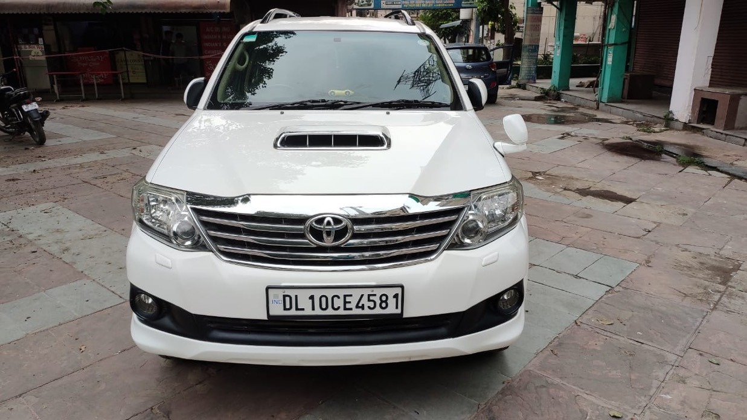
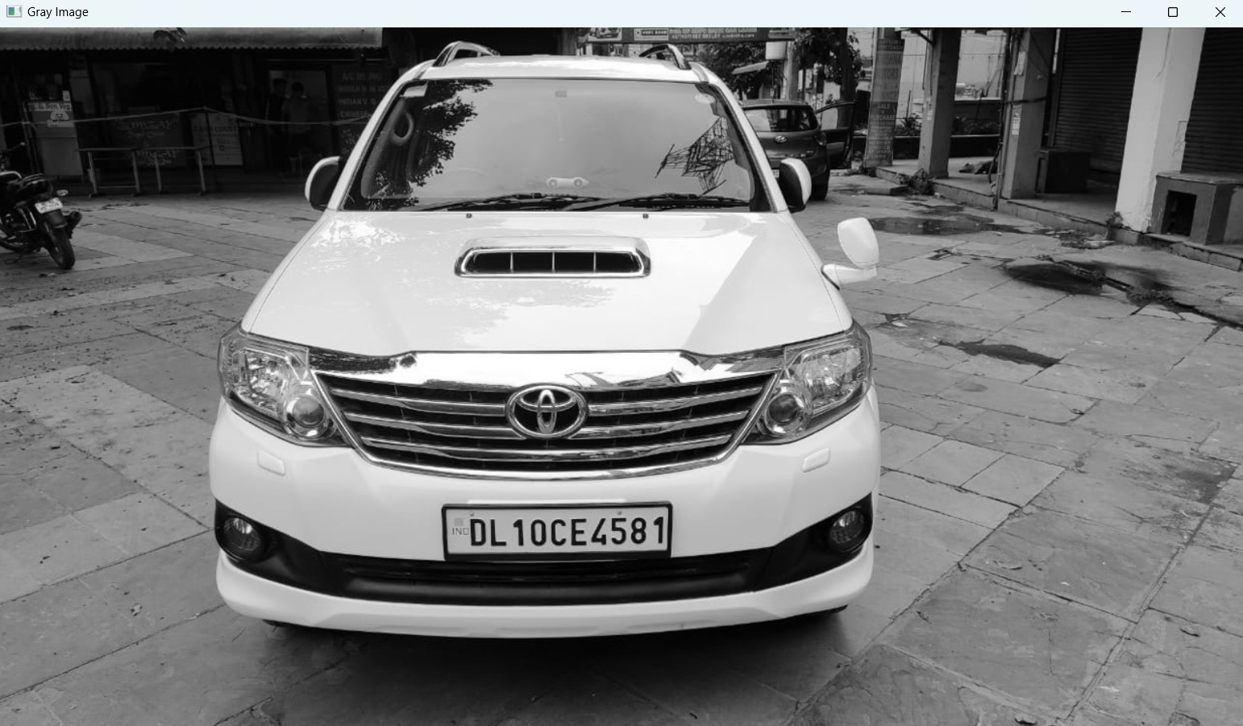
NUMBER PLATE DETECTION PROCESS
Step 1: Image Preprocessing Convert the input car image to grayscale for easier processing.
gray = cv2.cvtColor(image, cv2.COLOR_BGR2GRAY)
Input Image
Grayscale Image

Slide 6
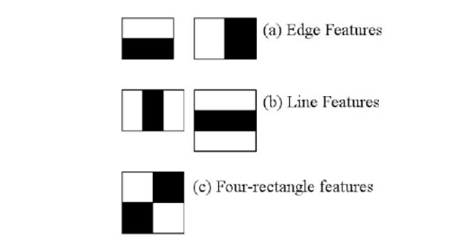

NUMBER PLATE DETECTION PROCESS
Step 2: Number Plate Detection Use the Haar Cascade classifier to detect the region where the number plate is located.
plates = plate_cascade.detectMultiScale(gray_img, scaleFactor=1.1, minNeighbors=4)

Slide 7
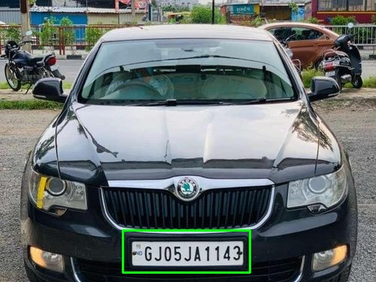
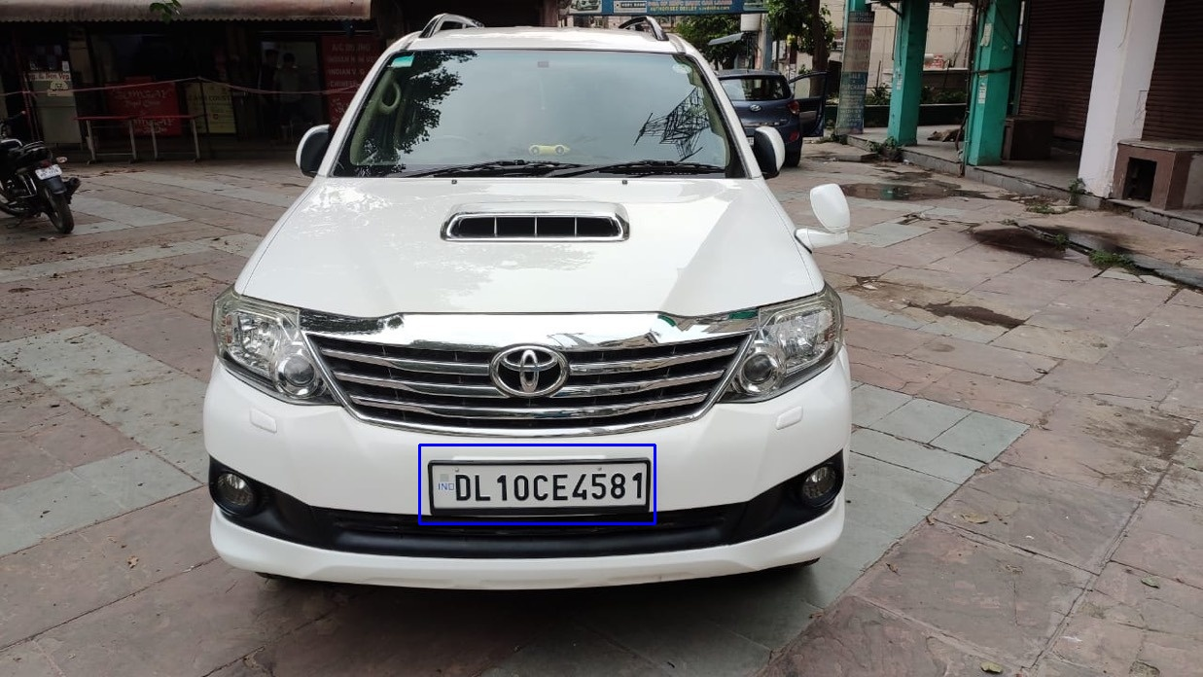
NUMBER PLATE DETECTION PROCESS
Step 3: Highlight the Detected Plate Draw a rectangle around the detected number plate region.
cv2.rectangle(image, (x, y), (x + w, y + h), (255, 0, 0), 2)

Slide 8
ALGORITHM AND AI CONTRIBUTION
1.Haar Cascade Classifier :
Haar Cascade is a machine learning object detection algorithm used to identify objects in images.
For this project, we use the Haar Cascade Classifier specifically trained for number plate detection.
Steps:
Convert the image to grayscale for easier processing.
Apply the Haar Cascade classifier to detect the number plate region.
Draw a bounding box around the detected plate in the image.
Image Preprocessing :
Convert the image to grayscale using OpenCV to simplify feature extraction.
Grayscale images reduce complexity, enhancing the accuracy and speed of the detection process.
Bounding Box Creation :
Once the plate is detected, a rectangle is drawn around the number plate using OpenCV’s cv2.rectangle() function.
The bounding box helps visually highlight the detected plate on the image.

Slide 9
HOW AI HELPS IN THIS PROJECT
AI-Based Object Detection:
The Haar Cascade algorithm is a machine learning approach that uses pre-trained models to detect specific objects like number plates in an image.
AI enables pattern recognition by learning from positive and negative samples (e.g., number plates and non-number plates) to accurately detect objects in real-world scenarios.
Improving Efficiency:
Automating number plate detection saves time and eliminates the need for manual intervention, improving the efficiency of systems such as traffic monitoring and automated toll systems.
Enhancing Accuracy:
The pre-trained model and image processing techniques reduce errors associated with manual detection and recognition.

Slide 10
RESULTS
Display a sample image of a car before and after the number plate detection.
Show a highlighted region around the number plate in the "after" image.
Before Detection
After Detection

Slide 11
CHALLENGES FACED
Image Quality: Low-resolution or noisy images can reduce detection accuracy.
Lighting Conditions: Variations in lighting affect the visibility of the number plate.
Plate Size and Position: Plates of varying sizes or angles can be difficult to detect in certain conditions.

Slide 12
FUTURE SCOPE
Real-Time Detection:
Implement number plate detection in video feeds for real-time monitoring.
Improved Detection:
Optimize the detection algorithm for faster and more accurate results under diverse conditions.
Multiple Number Plate Detection:
Extend the system to detect multiple plates in a single image for parking lots or traffic monitoring.

Slide 13
CONCLUSION
This project demonstrates the use of AI and image processing techniques for detecting vehicle number plates.
It provides a foundation for automating vehicle identification in various real-world applications.

Slide 14
THANK YOU

